Slide 1

Super Duper Note App 9000
Aidan Cram -1801447
Notes:
Hello, my name is Aidan, this is my presentation about my app the Super Duper Note App 9000

Slide 2
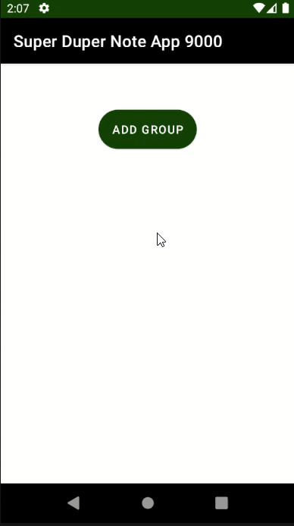
Video

Slide 3
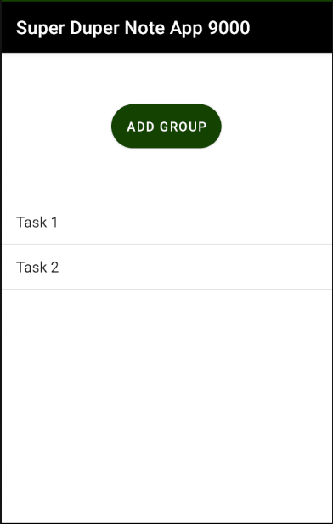
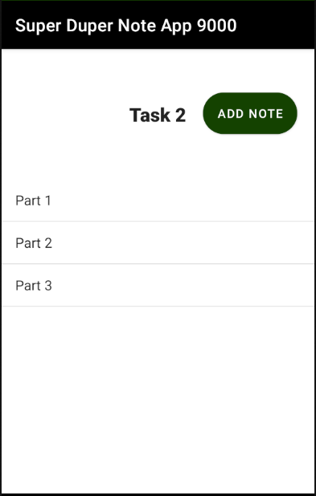
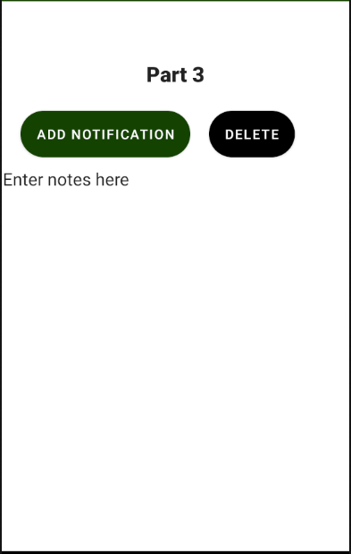
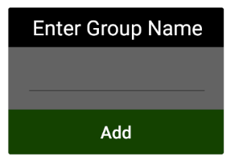
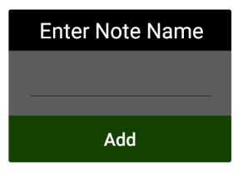
Flow Diagram
Group List
Note List
Note Page
Add Group
Add Note
Notes:
As you can see the main part of the app follows a simple linear progression. There are three main pages which you can navigate backwards and forwards through.
However, you can also see that there are two buttons to create new list items. These open popup activity’s which send you back a page when they return.

Slide 4
Hierarchy
Main Page
Groups
Android Dev
Task 1
Task 2
Notes
Coding
Design
Start
Finish
Part 1
Part 2
Note
Code App
Comment Code
Test Code
Wireframe
Pseudocode
Make shed
Tidy Tools
Planning
Working
Notes:
As you may have surmised from the previous slide there are three layers to the app. The first is the list of Groups.
For example; Tasks 1 and 2
Then when you select one of them it will take you to a page with a list of Notes. This is a list specific to the group selected such as parts one and two.
From here you can select one of the notes, which will take you to the Note Page
This is where the text of the note is stored and from where the delete and notification buttons can be pressed.
This is where you can see the hierarchical structure that keeps notes organised and allows for easy navigation.
This is because while there may be lots of different notes, there is only one way to get to a note, and only one way to get out.

Slide 5
Features
Lists
Note taking
Life Cycle
Notes:
There are three main features in this app that I feel are demonstrative of some really interesting coding.
The first is the Lists that display the groups and notes in the app
The second is the Note Taking part that uses some similar principals
The last part is the use of the Life Cycle. I’ve really made use of it in some important places to make sure that the code is triggering at the right points

Slide 6
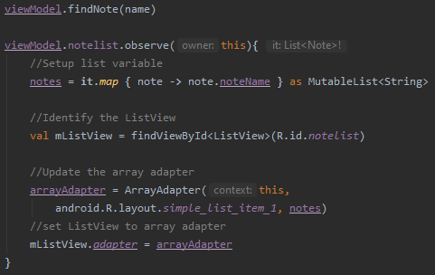
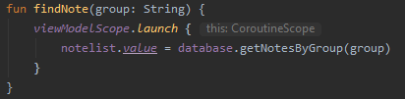
Lists
Observe
Coroutine
Notes:
The main part to look at with the Lists functionality is the use of observes and coroutines.
Obviously using coroutines is useful for increasing the efficiency of the program. However it does present some issues. Namely in the fact that it can’t return values.
To get around this problem I created an observe on the variable that the coroutine would update. In doing so I could call the code that would update the List without having to continually loop through it

Slide 7
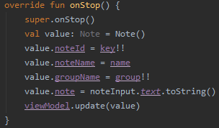
Note Taking
Notes:
The Note taking function also uses the same principle of observes and coroutines. However, this functionality also uses the onStop override to call the update function
This is useful as it means that no matter what happens the onStop will always be called and therefore definitely save the content of the note.

Slide 8
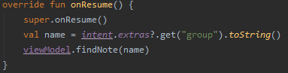
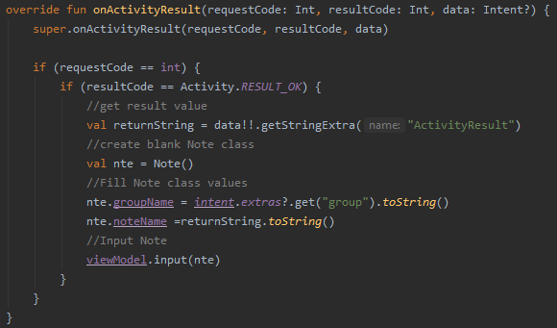
Life Cycle
onStop
onResume
onActivityResult
Notes:
The onStop is not the only use of the life cycle in this project. There are two other main uses that I found for it.
First is onResume. This ensures that when the page is loaded it will always have the most up to date values by running the findNote function every time the screen loads.
The other is onActivityResult. This one is used to input the retuned value from the input popup into the database. It’s particularly useful as in this case we want to use the activityResult string so we know the name entered for the Group or Note

Slide 9
UI Usability
Colour Choice
Text Style
Layout
Intuitive
Notes:
Obviously the end user isn’t able to appreciate the coding of the program but there are other elements that they will see. This is why the usability is so important.
There where four UI considerations when designing this App.
The first is the colour choice of the App. This is important as a poor choice of colours can make the app hard to use and even seemingly good choices can be problematic if colour-blindness is not considered.
This is why I chose to use bold colours with a strong contrast that ensures that it is easy to see.
Next is Text Style. Poor choice of text style can be the difference between a clear UI and something that the user finds unusable. This is why I chose a standard text style and made all the title text Bold.
This made sure that everything was easy to read.
The other two considerations for usability are a little harder to define but no less important.
When it comes to layout it is easy to identify when it is done well but can be difficult to articulate why. With this App I chose to keep it simple, to this end I kept all buttons well spaced at the top of the screen and all the content below this section.
This clearly separates the screen and keeps all the functions in there own section. Giving the app a clear separation
The last consideration is how intuitive the App is. To achieve this I ensured that the app followed a liner flow that the user would find easy to follow. Each button links to a new page that cleanly branches from the home page meaning that the user will always get back to the main page by going back twice and can’t get lost.

Slide 10
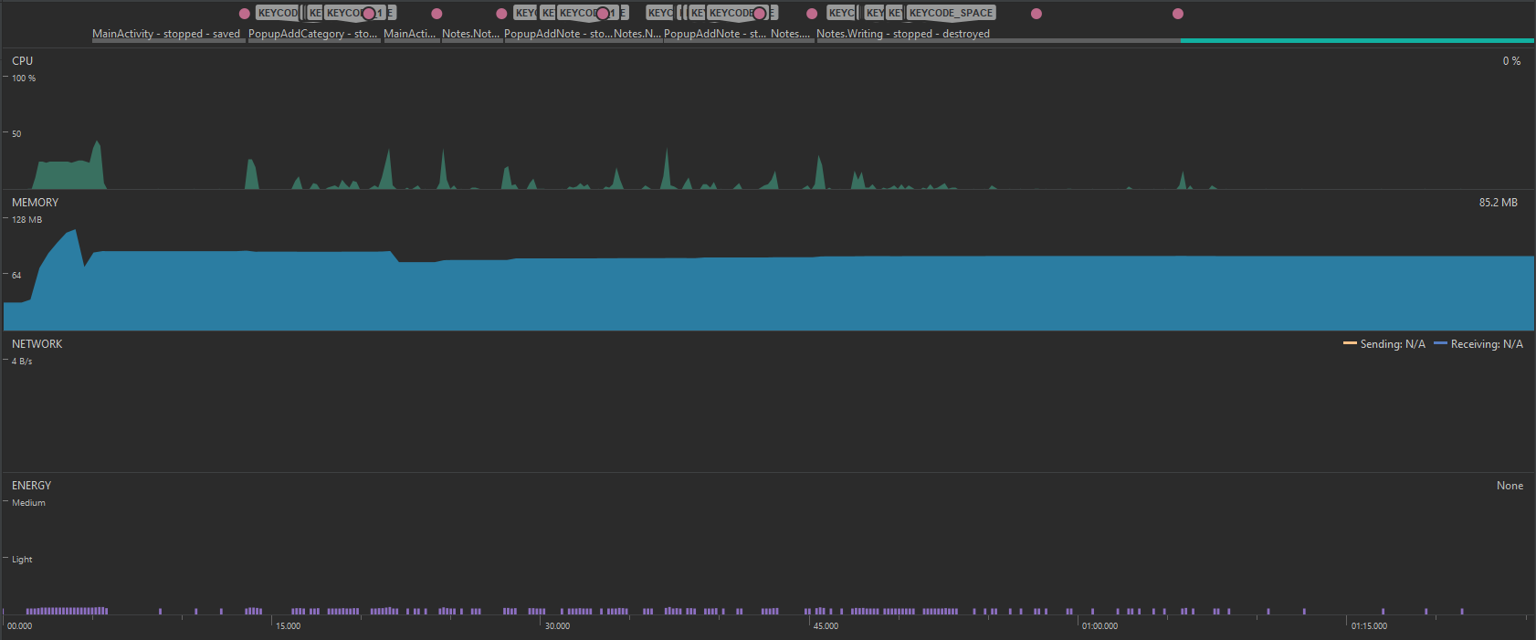
Performance
Notes:
Ensuring that the App preforms well is obviously an important consideration as users will be put off by long loading times and unnecessary high resource consumption is always something that should be avoided.
As you can see here I recorded the performance of the app as I used all the features and at no point was there an unexpected increase in the resource usage of the app when any of these functions were used.
This is a good indicator that no individual part of the App has been constructed in an inefficient way and proves that there are no performance issues like infinite recursion.

Slide 11
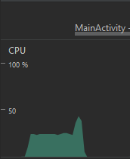
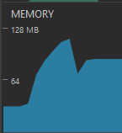
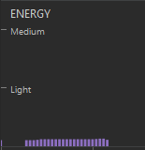
Performance Breakdown
Notes:
The only point where we see any spike in recourse consumption happens when the App starts. This is to be expected and because this is only happening at the start and is not a major spike in consumption it is not a serious concern.

Slide 12
Performance Benefits
Observe
List View
Coroutine
Notes:
Now, there are a number of reasons for this efficient recourse usage. Here I identify three of the main reasons.
First is the observe code I mentioned earlier. This obviously eliminates the need for a manual listener code that would constantly be running.
Next is the List View. When I started this App List views where not yet a legacy item. However, when I became aware of the benefits of recycler views I looked into replacing the List views. When I was looking at it I realised that the main limitation of list views was in having a large list of items to show. Thankfully, this issue was limited by how the App is structured because all note are grouped it limits the number of notes shown on a single page. This, combined with how late in development this change was considered resulted in the decision to retain the list views. However, there are some small benefits to using list views. They have low resource usage and require less implementation so it’s not fair to suggest that it’s a total loss to have developed the program in this way.
The last consideration is coroutines. These are obviously very useful for increasing performance by ensuing that the tasks are spread among threads. This can seriously increase performance if used correctly, however, it is important to consider the limitations involved such as the inability to return values.

Slide 13
Performance Improvements
Data Binding
Recycler View
Coroutine
Notes:
While this App is very efficient there are always improvements that can be made. I’ve identified three improvements that would increase the performance.
Firstly according to the android documentation Data Binding will increase performance. While this can involve a lot of work to implement on a pre-existing app it can nonetheless provide performance benefits.
Next is the recycler view. As I mentioned, this is preferable to a List View in many scenarios so it would be preferable to implement that as a way to ensure that the issue with list views don’t occur.
The last improvement is Coroutines. Obviously, as I mentioned earlier, I have used coroutines in the App, however, it is always important to consider where more functions can be run in separate threads.

Slide 14
Security
Permissions
User Data
Notes:
There are thankfully few considerations that need to be made for the security of this App. This is because this app uses no Permissions which eliminates security concerns there.
The App also does not use any personal information such as passwords or date of birth. This reduces the concern over the storage of data.

Slide 15
Future Work
Performance
Notification
Add Item
Notes:
There are three main areas to focus on in future.
First is the ones we discussed earlier which include a few performance increases.
Aditionaly, an expansion of the Notification function. I want to expand the notification function so you can choose when you want to set the reminder.
Finally, another idea I had is to, instead of adding groups then notes, to instead allow for adding either a group or a note. This would allow for better organisation because users could group notes however they want.
For example, there could be a University group that has an Android group. Then you could add a note with a list of tutorials and a new group in which you have a note for each week of work.

Slide 16
References
Kotlin Fundamentals:
Room Database
Kotlin Fundamentals:
Coroutines
Advanced Kotlin:
Notifications
Notes:
I made heavy use of the Kotlin codelabs for constructing this project. However there were three main Tutorials that I followed.
This was the fundamentals on Room Databases and Coroutines. As well as the Advanced Tutorial for Notifications.

Slide 17
Questions?
1801447@uad.ac.uk
Notes:
Thank you for listening and if you have any questions then don’t hesitate to contact me.

